Slide 1
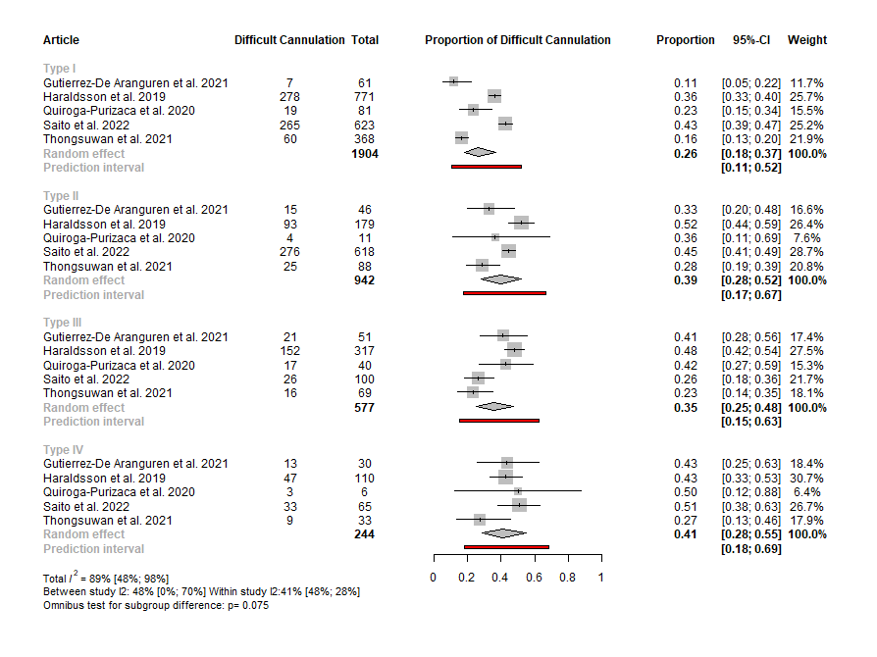
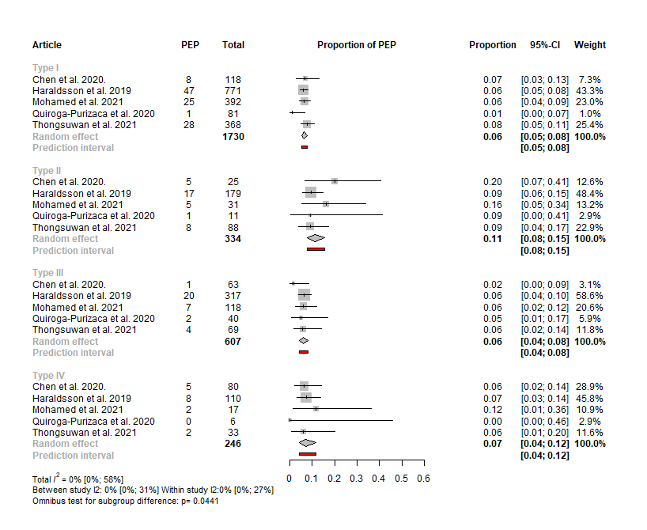
Investigating the influence of papilla morphology on ERCP outcomes –
a systematic review and meta-analysis
Edina Tari, Endre Botond Gagyi, Anett Rancz, Dániel Sándor Veres, Péter Hegyi, Bálint Erőss
Introduction and aims
Endoscopic Retrograde Cholangiopancreatography (ERCP) is the most commonly used therapeutic procedure for pancreaticobiliary disorders. Although the incidence of adverse events is high, how to achieve safe and effective cannulation is still a question. We aimed to assess the influence of papilla morphology on ERCP outcomes and adverse events.
Mehods
PROSPERO registration number: CRD42022360894. Three medical databases were systematically searched from inception in October 2022. Studies detailing the cannulation process or the rate of adverse events in the context of papilla morphology were included. Pooled event rates were calculated. For the primary classification of the papilla, the Haraldsson system was used.
Results
Forest plot representing the pooled event rate of difficult cannulation in the different papilla types using the Haraldsson classification
Forest plot representing the pooled event rate of post-ERCP pancreatitis in the different papilla types using the Haraldsson classification
A total of 17 studies were eligible, and 14 of them were included in the quantitative synthesis. In studies using the Haraldsson classification, certain morphological variants had a higher tendency for difficult cannulation, compared to the normal papilla. The event rate was the highest in type IV papilla (41%; CI: 28–55), followed by type II (39%; CI:28–52). For post-ERCP pancreatitis, the event rate was the highest in type II papilla (11%; CI: 8–15). There was no difference in the event rate for cannulation failure and post-ERCP bleeding between the different papilla types.
Conclusion
Our results suggest that certain morphologies of the papilla have a higher risk for difficult cannulation and are more prone to adverse events.
CENTRE FOR
TRANSLATIONAL MEDICINE
SEMMELWEIS.HU/TMK
TMK@SEMMELWEIS-UNIV.HU

